Slide 1

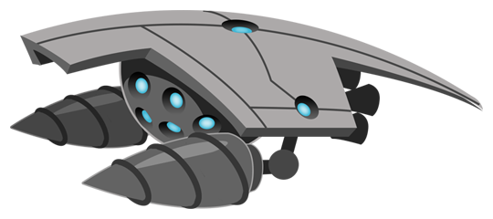
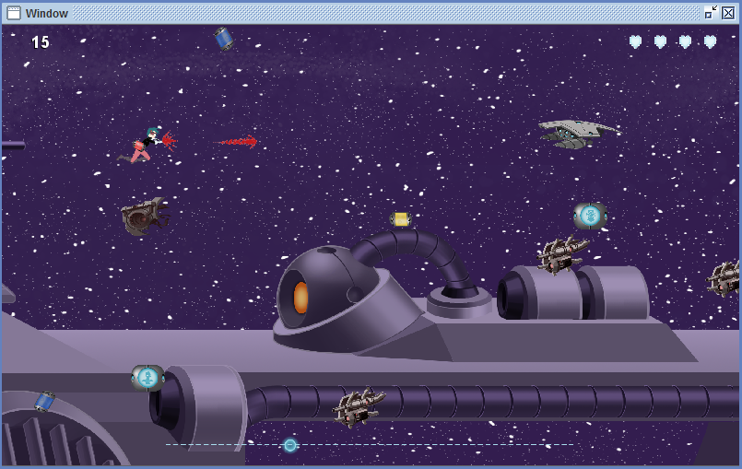
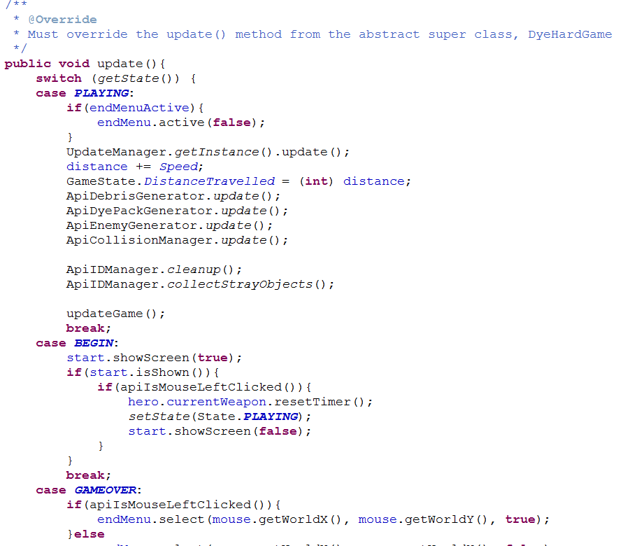
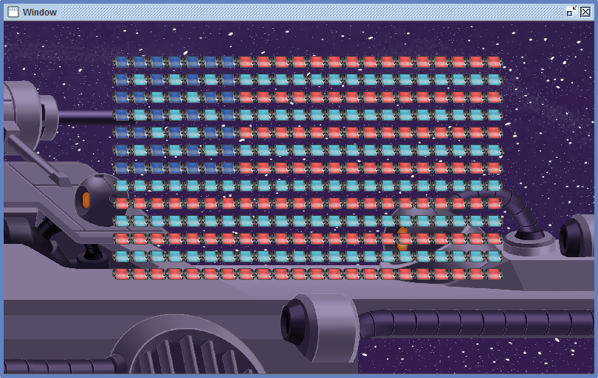








Educational Game API – Dye Hard Procedural API
Summer 2016 Capstone Project || Presenter: Vuochly (Nin) Ky || Faculty Advisor: Kelvin Sung || Sponsor: Rob Nash
Project Overview
What I have done & Results
The purpose of this project is to design a tool that teaches computer science concepts. My team and I want to engage and teach computer science concepts to kids using video games.
Project Objective
Study existing Dye Hard object-oriented library
Design and develop a procedural API
Create reference materials for the procedural API – Demos
Create teaching materials for novice programmers
Developed a Procedural API based off of the Dye Hard object-oriented game library
From 90+ classes to less than 10 classes (Functionalities)
Six demos to demonstrate how the Procedural API can be used
Nine labs and a tutorial write-up for each as introductory computer science lessons
Hero hero = new Hero();
apiStartHero();
hero.currentWeapon.fire();
apiHeroFirePaint();
Procedural API game window
Problem
We want to reach out and engage kids in programming
We want to use the Dye Hard game library; however, the library is not usable for novice programmer
We need something simple – Procedural API
acknowledgement
Special thanks to:
Professor Kelvin Sung for guidance and support
Rob Nash for being my sponsor
Janet McDaniel
The Dye Hard procedural API is more than just a game API
Tools used
Reflection
Learned a new tool
Worked with game API
Collaboration
Time management
Documentation is very important
Reading code written by other people
Notes:
It should be easy for kids who has never programmed or has little knowledge about programming
We don’t wan to expose the Object oriented stuff to novice programmers

